Slide 1


Slide 2
What is react?
Open source library for building user interfaces
Not a framework
Focus on UI
Rich ecosystem

Slide 3
Why learn react?
Created and maintained by facebook
More than 100k stars on Github
Huge community
In demand skillset (Stackoverflow developer yearly survey)

Slide 4
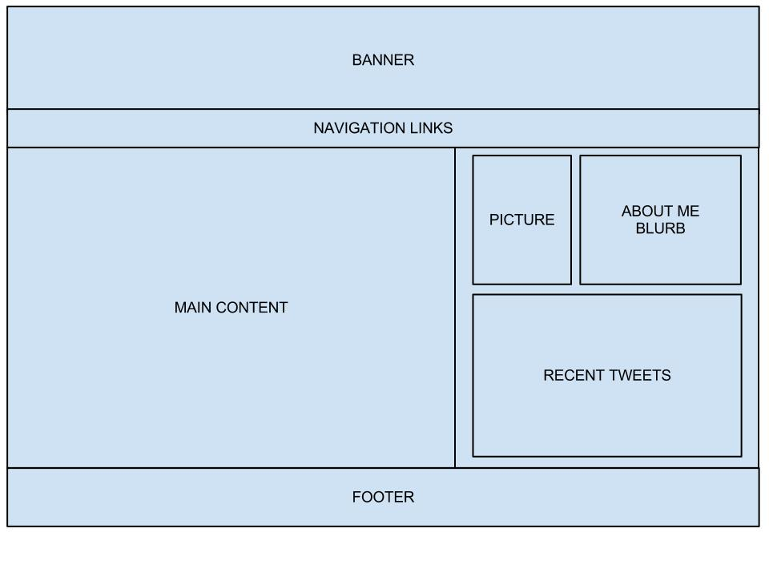
Component Based Architecture

Slide 5


Reusable Code
REACT
ANGULAR
VUE
Article Component

Slide 6
REACT is Declarative
Tell react what you want and react builds the actual UI
React will handle efficiently updating and rendering of the components
DOM updates are handles gracefully in react

Slide 7
More on why React?
Seamless integration of react into any of application
-Portion of a page
-Complete page or
-Entire application
React native for mobile applications

Slide 8
PREREQUISITE
HTML, CSS and JAVASCRIPT fundamentals
ES6
Javascript: ‘This’ keyword, filter, map and reduce
ES6 – let &const, arrow functions,template literals, default parameters, object literals,rest and spread operators, and destructuring assignment
React from scratch

Slide 9
Content
React Fundamentals
HTTP
Routing
Redux
Context API
Utilities

Slide 10
‘HELLO WORLD’ APPLICATION

Slide 11
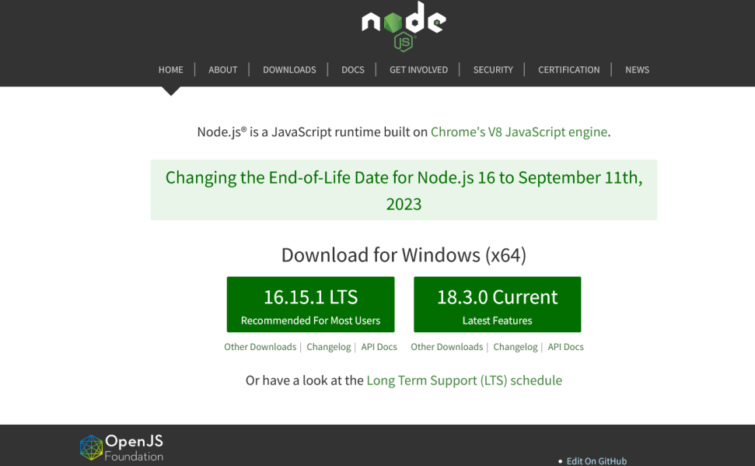
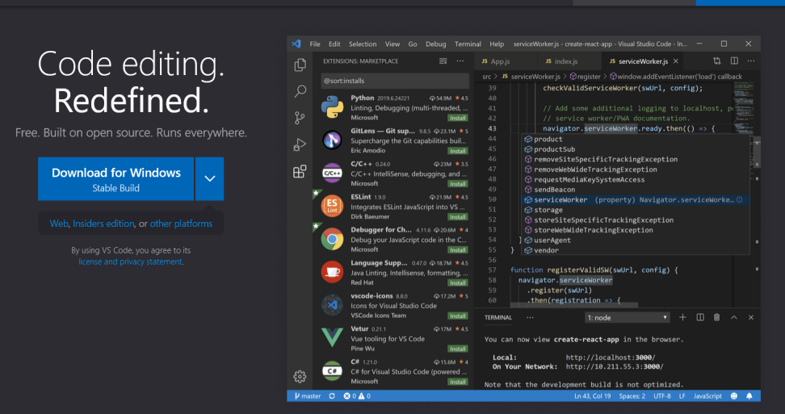
Requirement
Nodejs
Choice Text Editor

Slide 12
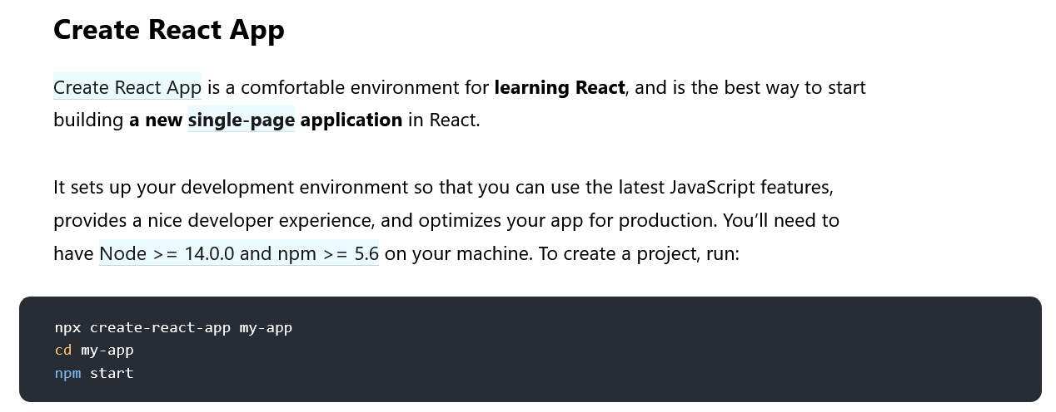
Create React App

Slide 13
Create React App
npx
npm
npx create-react-app <project_name>
npx - npm package runner
npm install create-react-app --g
create-react-app <project_name>

Slide 14
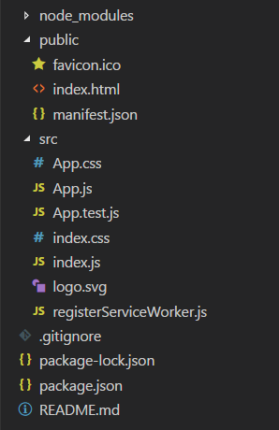
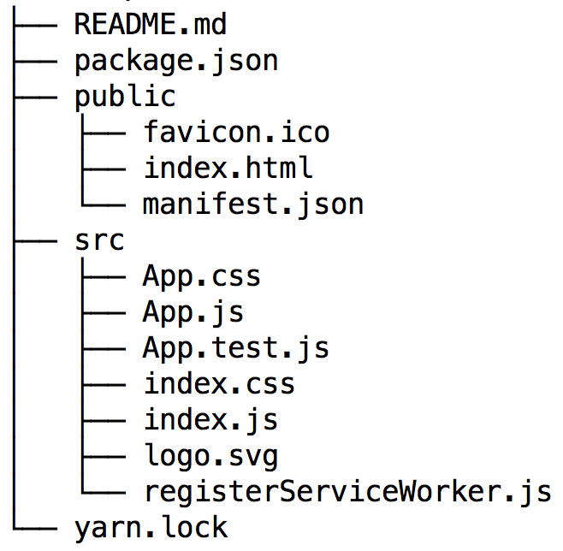
Folder Structure

